Slide 1
Object-Oriented Programming (OOP)
Lecture No. 1

Slide 2
Course Objective
Objective of this course is to make students familiar with the concepts of object-oriented programming
Concepts will be reinforced by their implementation in C++

Slide 3
Course Contents
Object-Orientation
Objects and Classes
Overloading
Inheritance
Polymorphism
Generic Programming
Exception Handling
Introduction to Design Patterns

Slide 4
Books
C++ How to Program
  By Deitel & Deitel
The C++ Programming Language
  By Bjarne Stroustrup
Object-Oriented Software Engineering
  By Jacobson, Christerson, Jonsson, Overgaard

Slide 5
Grading Policy
Assignments 20 %
Group Discussion 10 %
Project/Viva/Report 40%
Quizzes 30 %

Slide 6
Object-Orientation (OO)

Slide 7
What is Object-Orientation?
A technique for system modeling
OO model consists of several interacting objects

Slide 8
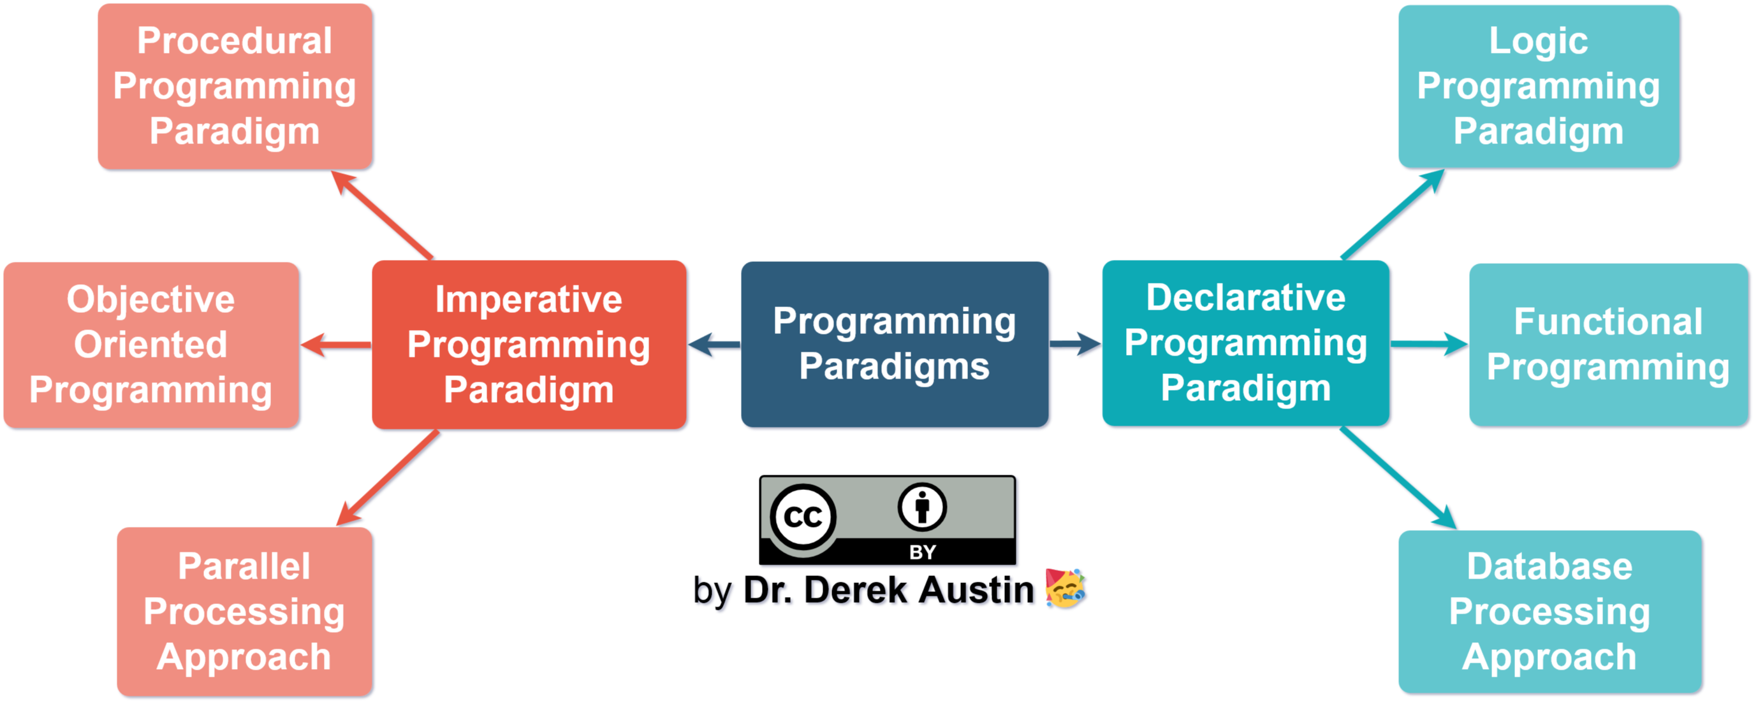
Programming paradigm
Programming paradigms are a way to classify programming languages based on their features.

Slide 9
What is a Model?
A model is an abstraction of something
Purpose is to understand the product before developing it

Slide 10
Examples – Model
Highway maps
Architectural models
Mechanical models

Slide 11



Example – OO Model

Slide 12
…Example – OO Model
lives-in
Objects
  Ali
  House
  Car
  Tree
Interactions
  Ali lives in the house
  Ali drives the car
Ali
House
drives
Car
Tree

Slide 13
Object-Orientation - Advantages
People think in terms of objects
OO models map to reality
Therefore, OO models are
  easy to develop
  easy to understand

Slide 14
What is an Object?
An object is
Something tangible (Ali, Car)
Something that can be apprehended intellectually (Time, Date)

Slide 15
… What is an Object?
An object has
State (attributes)
Well-defined behaviour (operations)
Unique identity

Slide 16
Example – Ali is a Tangible Object
State (attributes)
  Name
  Age
behaviour (operations)
  Walks
  Eats
Identity
  His name

Slide 17
Example – Car is a Tangible Object
State (attributes)
  - Color
  - Model
behaviour (operations)
  - Accelerate - Start Car
  - Change Gear
Identity
  - Its registration number

Slide 18
Example – Time is an Object Apprehended Intellectually
State (attributes)
  - Hours - Seconds
  - Minutes
behaviour (operations)
  - Set Hours - Set Seconds
  - Set Minutes
Identity
  - Would have a unique ID in the model

Slide 19
Example – Date is an Object Apprehended Intellectually
State (attributes)
  Year - Day
  Month
behaviour (operations)
  - Set Year - Set Day
  - Set Month
Identity
  - Would have a unique ID in the model

Slide 20
Information Hiding
Information is stored within the object
It is hidden from the outside world
It can only be manipulated by the object itself

Slide 21
Example – Information Hiding
Ali’s name is stored within his brain
We can’t access his name directly
Rather we can ask him to tell his name

Slide 22
Example – Information Hiding
A phone stores several phone numbers
We can’t read the numbers directly from the SIM card
Rather phone-set reads this information for us

Slide 23
Information Hiding
Advantages
Simplifies the model by hiding implementation details
It is a barrier against change propagation

Slide 24
Encapsulation
Data and behaviour are tightly coupled inside an object
Both the information structure and implementation details of its operations are hidden from the outer world

Slide 25
Example – Encapsulation
Ali stores his personal information and knows how to translate it to the desired language
We don’t know
  How the data is stored
  How Ali translates this information

Slide 26
Example – Encapsulation
A Phone stores phone numbers in digital format and knows how to convert it into human-readable characters
We don’t know
  How the data is stored
  How it is converted to human-readable characters

Slide 27
Encapsulation – Advantages
Simplicity and clarity
Low complexity
Better understanding

Slide 28
Object has an Interface
An object encapsulates data and behaviour
So how objects interact with each other?
Each object provides an interface (operations)
Other objects communicate through this interface

Slide 29
Example – Interface of a Car
Steer Wheels
Accelerate
Change Gear
Apply Brakes
Turn Lights On/Off

Slide 30
Example – Interface of a Phone
Input Number
Place Call
Disconnect Call
Add number to address book
Remove number
Update number

Slide 31
Implementation
Provides services offered by the object interface
This includes
  Data structures to hold object state
  Functionality that provides required services

Slide 32
Example – Implementation of Gear Box
Data Structure
  Mechanical structure of gear box
Functionality
  Mechanism to change gear

Slide 33
Example – Implementation of Address Book in a Phone
Data Structure
  SIM card
Functionality
  Read/write circuitry

Slide 34
Separation of Interface & Implementation
Means change in implementation does not effect object interface
This is achieved via principles of information hiding and encapsulation

Slide 35
Example – Separation of Interface & Implementation
A driver can drive a car independent of engine type (petrol, diesel)
Because interface does not change with the implementation

Slide 36
Example – Separation of Interface & Implementation
A driver can apply brakes independent of brakes type (simple, disk)
Again, reason is the same interface

Slide 37
Advantages of Separation
Users need not to worry about a change until the interface is same
Low Complexity
Direct access to information structure of an object can produce errors

Slide 38
Messages
Objects communicate through messages
They send messages (stimuli) by invoking appropriate operations on the target object
The number and kind of messages that can be sent to an object depends upon its interface

Slide 39
Examples – Messages
A Person sends message (stimulus) “stop” to a Car by applying brakes
A Person sends message “place call” to a Phone by pressing appropriate button

